Slide 1

Greek & Latin Grammar
Gregory Crane, Anna Krohn, 2015

Slide 2
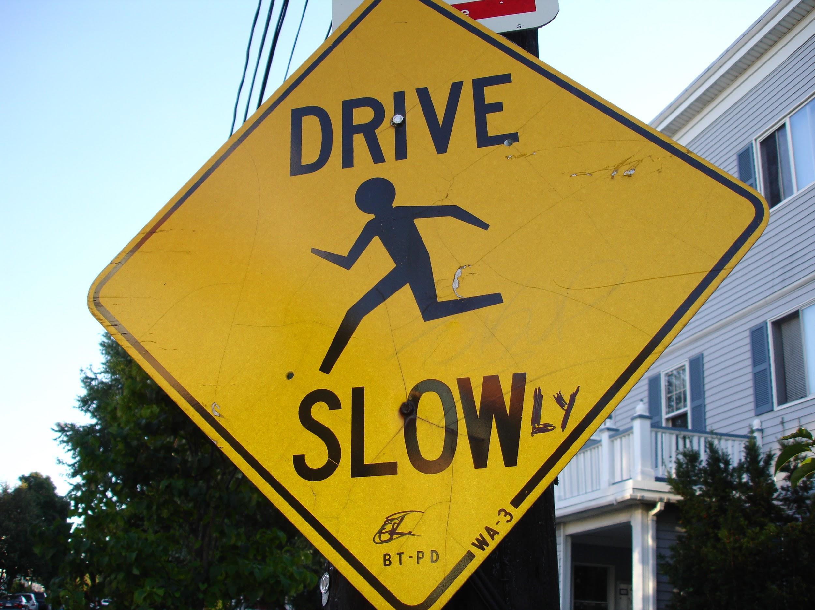
What is Grammar?
-γραμματικὴ τέχνη “the art of letters” -set of rules that dictate how a language is used
-morphology and syntax
http://en.wikipedia.org/wiki/Grammar
http://farm4.staticflickr.com/3237/2912898000_572868e248_o.jpg
Notes:
-morphology= linguistic units: root words, parts of speech
-syntax= how you arrange words, rules for coherent speech/writing

Slide 3
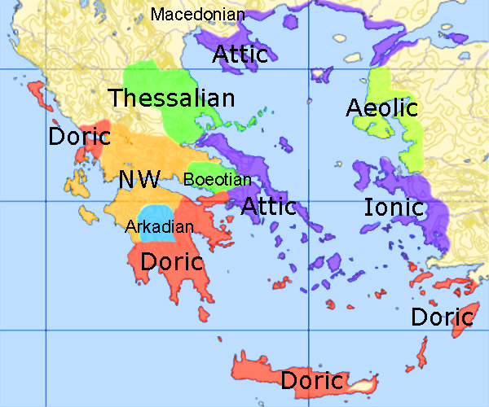
Greek Overview
-Indo-European language
-Many dialects
-basic traits
-tonal
-inflected
-written
-boustrophedon, left-to-right
-accents, breathing marks
-loose word order
-Poetry vs. Prose
-meter
http://upload.wikimedia.org/wikipedia/commons/2/29/Greek-dialects-mod.jpg
Notes:
-indo european, refers to a family of languages that are spread across europe, the middle east, and the indian subcontinent
-dialects, when you learn Greek you are taught Attic, the homeric epics are in mostly Ionic with some Aeolic
-“ox-turning” from βοῦς, bous, “ox” and στροφή, strophē, “turn”; bidirectional
-diacritical marks added mostly in the Hellenistic period, 3rd century BCE
-loose word order allows for a lot of variations on how a sentence can be arranged, meaning is in the word endings, not as much in words’ relations to each other, means playing with meter in poetry is possible
-meter is rhythmic structure of verse, homeric epics written in dactylic hexameter; this is more of a factoid for you, a bit beyond the scope of our class

Slide 4
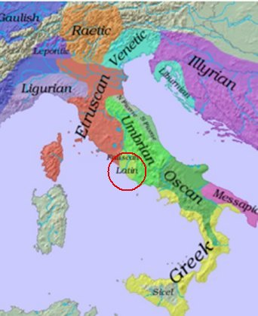
Latin Overview
-Indo-European
-one of many Italian languages, pushed out all of the others
-basic traits
-inflected
-loose word order
-Poetry vs. Prose
-meter
http://academic.brooklyn.cuny.edu/modlang/carasi/courses/00.SPRING15.TEACHING/0003.ITAM.SPRING.15/ITAM.COURSE.MATERIALS/ITAM.LECTURES/TOPICAL.LECTURES/TOPICAL.italian.history.htm

Slide 5
What’s in a Word?
-For Greek and Latin, quite a lot!
-Odyssey, 1.1-2
ἄνδρα μοι ἔννεπε, μοῦσα, πολύτροπον, ὃς μάλα πολλὰ
πλάγχθη, ἐπεὶ Τροίης ἱερὸν πτολίεθρον ἔπερσεν:
Tell me, O Muse, of the man of many devices, who
wandered full many ways after he had sacked the sacred citadel of Troy.
-Sextus Propertius, Elegies(1)
Cynthia prima suis miserum me cepit ocellis,
contactum nullis ante cupidinibus.
Cynthia's eyes first took me, poor unfortunate
captive, previously affected by no passion:
Notes:
-Greek/English, Latin/English sentence alignment
-general structural things
-notice that the word orders don’t follow, word order can emphasize words or indicate things the author wants the reader to notice
e.g. - in the Propertius, Cythia...ocellis frame the line, “capturing” the words (miserum me) between, the structure mirrors/reinforces the content
-one Greek or Latin word can be many English, and sometimes English has to add words to have the Greek or Latin make sense in the translation
e.g. - in Hom. most freq., μάλα πολλά very many, what the ‘many’ refers to is omitted, supposed to understand from the wandering that it is a sense of paths, ways, near and far, etc.

Slide 6
The Basic Rundown
-Parts of speech
-verbs, nouns, pronouns, adverbs, adjectives, prepositions, conjunctions, and articles
-Parts of a sentence
-subject, verb/predicate, object
-modifiers, phrases, clauses
Notes:
morphological, then syntatical

Slide 7
Inflection
-What is it?
-word stem and endings
-change the ending to reflect how a word is being used in a sentence
-Like goddess -> goddesses or sacrifice -> sacrifices -> sacrificed -> sacrificing
-θεᾱ́, goddess
θεᾱ́ θεαί
θεᾶς θεῶν
θεᾷ θεαῖς
θεᾱ́ν θεᾱ́ς
θεᾱ́ θεαί
-θύω, sacrifice
(present indicative active)
θύω θύομεν
θύεις θύετε
θύει θύουσι
-dea, goddess
dea deae
deae dearum
deae deis
deam deas
dea deis
-sacrifico, sacrifice
(present indicative active)
sacrifico sacrificamus
sacrificas sacrificatis
sacrificat sacrificant
Notes:
-word stem/root is the (mostly) unchanging portion of a word
-endings for all parts of speech follow patterns

Slide 8
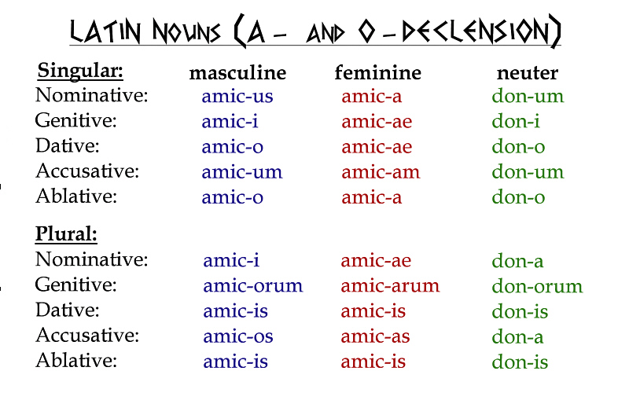
Nouns
-declensions, groups of nouns that take similar forms
-cases (nominative, genitive, dative, accusative, ablative[Latin], vocative)
-numbers (singular, dual, plural)
-genders (masculine, feminine, neuter)
-word agreement
http://www.learnlangs.com/latin/pictures/Latin_nouns_AO.jpg
Notes:
-cases indicate syntactic purpose (subject, object, etc)
-numbers, how many of the noun
-gender, all nouns have a gender, doesn’t really have to do with what the noun means, more just a catagory for how the word behaves when being declined (what forms it takes), though sometimes you get ones that match up
-agreement, related pronouns, adjectives, etc. must match their corresponding noun in case, number, and gender

Slide 9
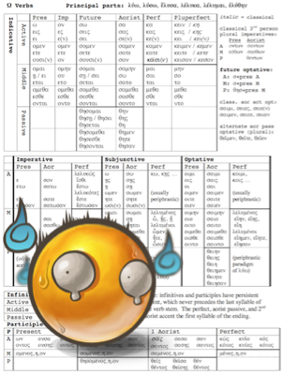
Verbs
-person (1st, 2nd, 3rd)
-tense (present, imperfect, future, aorist[Greek], perfect, pluperfect, future perfect)
-moods (indicative, subjunctive, optative[Greek], imperative)
-voices (active, middle[Greek], passive)
-non-finite forms, infinitive and participles
-augments, reduplication, contraction
http://edge.papercutpm.com/wp-content/uploads/2011/10/greek-conjugations.png
Notes:
-like nouns in that they have these traits, but there are more and it gets a bit more complicated
-typical chart of a full conjugation of a Greek verb, typical face of a beginning Greek student once they figure out what they’ve signed up for

Slide 10
We need to learn all this…?!
-No, not for this class! But you should realize that Greek and Latin words follow rules, recognize what might be happening with the words, and have some inkling that θύει, θύσει, and τέθυκε or sacrifico, sacrificabimur, and sacrificavisses are all from the same root word.

